Slide 1

Automated Meeting Room Booking System
- HACK-UNA mATATA

Slide 2
Hack-una Matata Members
AVANISH SANDILYA
AYUSH ANAND
BHAWANA MISHRA
DIVYANSHU GAUTAM
FIZA SAJID SHAIKH
JAGRIT VARINDANI
SIMRAN
SNEHA RAVINDRA PANSARE

Slide 3
Problem Statement
AUTOMATED MEETING ROOM BOOKING SYSTEM
Automates booking meeting room procedure in an organization
Functionalities Required:
1. Searching Room
2. Creating Room
3. Organizing Meeting
4, Booking Room

Slide 4
Introduction
Project Scope - Mechanized Booking System for Conference Helding
Contents - - Types of User : Admin, Managers, Members - includes Meeting Room, Users, Booking Information, Meeting etc
Key Pages - 1. Home Page 4. Meeting Room 2. Login Page 5. Schedule Page 3. Admin Page

Slide 5
Overview
Description – - Creating & Configuring rooms - Searching & Booking - Appending User Information - Scheduling Meeting - Managing Rooms & Meeting - Editing Details
Ensuring Business Rules
Financial concept - Crediting per hour usage of room

Slide 6
Feasibility Study
Technical Study – - Requirement Analysis: Software - 1. Backend - Java 2. Frontend - HTML, CSS, JS 3. Database - MySql
Operational Study – - Should be feasible in scheduling technical and legal foregrounds - Should qualify Test Cases – 1. Organizing Meeting Cases 2. Creating Room Cases

Slide 7
Code Snippets

Slide 8
Code Snippets

Slide 9
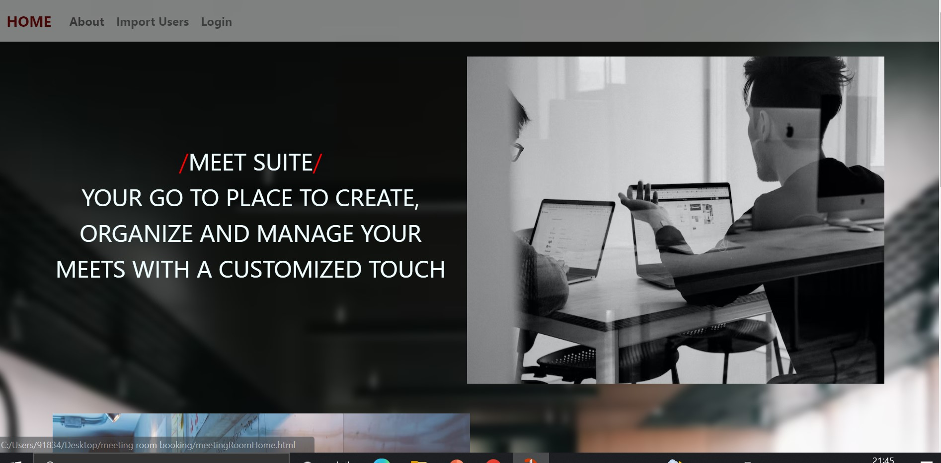
Snapshots

Slide 10
Thank You :)

